Slide 1
Proof as a cluster concept:
A conceptual tool to account for variance in mathematicians’ judgments
Keith Weber
Rutgers University

Slide 2
Thanks
To Benedikt Loewe and the conference committee for organizing this conference
To the Indian Council for Philosophical Research (ICPR), the International Association for Science and Cultural Diversity (IASCUD), and the Indo-European Research Training Network in Logic (IERTNiL) for funding the conference and to the Indian Science Academy (INSA) for their generous hospitality.

Slide 3
“Mathematical proof does not admit degrees. A sequence of steps in an argument is either a proof, or it is gibberish”
(Rota, 1997, p. 183).
“The concept of mathematical proof, like mathematical truth, does not admit degrees”
(Montano, 2012, p. 26).

Slide 4
Proof as a binary judgment
Mathematicians all agree on whether something is a proof.
  Azzouni (2004) attempted to explain why “mathematicians are so good at agreeing with one another on whether a proof convincingly establishes a theorem” (p. 84).
  “All agree that something either is a proof or it is not and what makes it a proof is that every assertion in it is correct” (McKnight et al, 2000, p. 1).
  Selden and Selden (2003) marveled at “the unusual degree of agreement about the correctness of arguments and the proof of theorems […] Mathematicians say an argument proves a theorem. Not that it proves it for Smith but possibly not for Jones” (p. 11).

Slide 5
Proof as a binary judgment
Mathematicians all agree on whether something is a proof.
  Azzouni (2004) attempted to explain why “mathematicians are so good at agreeing with one another on whether a proof convincingly establishes a theorem” (p. 84).
  “All agree that something either is a proof or it is not and what makes it a proof is that every assertion in it is correct” (McKnight et al, 2000, p. 1).
  Selden and Selden (2003) marveled at “the unusual degree of agreement about the correctness of arguments and the proof of theorems […] Mathematicians say an argument proves a theorem. Not that it proves it for Smith but possibly not for Jones” (p. 11).

Slide 6
Aims of this talk
Proofs can be thought of as a cluster concept (in the sense of Lakoff, 1997) and therefore do admit degree.
I will present an experiment, showing that and proposing why:
  Mathematicians do not agree on what constitutes a proof
  Mathematicians realize a proof for them might not be a proof to another mathematician (and vice versa)
  Mathematicians think the validity of some proofs is contextual
  Nonetheless, it still makes sense to say that prototypical proofs have objective validity.

Slide 7
Approaches for defining proof
In the philosophy of mathematics, there are two approaches to defining proof:
  Logical or formalist approach: Proof can be defined as a syntactic formal object. A sequence of sentences in an axiomatized logical theory with mechanical rules for how new sentences can be inferred from previous sentences.
  Sociological approach: Proof can be defined as the proofs that mathematicians actually read and write.

Slide 8
Problems with the sociological approach to proof
Defining proof purely descriptively as “the types of proofs that mathematicians produce” also does little work for us.
  As Larvor (2012) noted, “the field lacks an explication of ‘informal proof’ as it appears in expressions such as ‘the informal proofs that mathematicians actually read and write’” (p. 716).
This is pedagogically useless. We need some sense to describe similarities between (desired) student proofs and actual proofs.
  What’s to stop us from saying, “students should write proofs in LATeX”?

Slide 9
Problems with the sociological approach to proof
One might say what is needed is a way to distinguish essential properties of proof from nominal ones.
“This talk of essences made some sense for Plato and Aristotle, in whose works it was first deployed, as it reflects their broader metaphysical commitments. However, for modern thinkers who do not share those commitments, and even for those who do, it is very hard to defend: the most that can be made of essence is that it ‘is just the human choice of what to mean by a name, misinterpreted as being a metaphysical reality’ (Robinson, 1950, p. 155)”.
from Aberdein (2006)

Slide 10
Problems with the sociological approach to proof
In mathematics education, it is popular to define a proof as an argument that is convincing (e.g., Balacheff, 1987; Harel & Sowder, 1998) . Some in philosophy do so as well (Hersh, 1997).
However, many claim that mathematicians claim that some conjectures, like Goldbach’s conjecture, are regarded as true
(e.g,. Eccheverria,1996; or see my Weber, 2013)
Some further claim that there are cases where empirical arguments are more convincing than proofs (Fallis, 2003; Paseau, 2011).
For more complete arguments:
Weber, M. Inglis, & J.P. Mejia-Ramos (2014). How mathematicians obtain conviction: Implications for mathematics instruction and epistemic cognition. Educational Psychologist, 49, 36-58.

Slide 11
Is this a proof?

Slide 12
Is this a proof?
From Adamchik and Wagon (1997), published in the American Mathematical Monthly.

Slide 13
Is this a proof?
Notice that this proof:
Does not provide explanation
Involves untested hidden assumptions (Mathematica is reliable)
Gaps in the proof cannot easily be deductively verified by mathematicians (or at least it does not hint at a method other than use Mathematica)

Slide 14
Is this a proof?
Objection #1: This is a really strange proof.

Slide 15
Is this a proof?
Objection #1: This is a really strange proof.
  Yes, but it is representative of computer-assisted proofs that are not that uncommon.

Slide 16
Is this a proof?
Objection #1: This is a really strange proof.
  Yes, but it is representative of computer-assisted proofs that are not that uncommon.
Objection #2: Mathematicians who think computer-assisted proofs are actually proofs are simply mistaken.

Slide 17
Is this a proof?
Objection #1: This is a really strange proof.
  Yes, but it is representative of computer-assisted proofs that are not that uncommon.
Objection #2: Mathematicians who think computer-assisted proofs are actually proofs are simply mistaken.
  This would be a valid reply if one wanted to adopt a normative standard of proof. But if one wants to describe the proofs that mathematicians actually read and write, we cannot arbitrarily decide which ones to rule out based on our opinions of what proof ought to be.

Slide 18
Is this a proof?
Objection #3: The proof is controversial and would not be accepted by all mathematicians.
  I agree.
  So do the authors: “Some might even say this is not truly a proof! But in principle, such computations can be viewed as proofs” (Adamchik & Wagon, 1997, p. 852).
  This disagreement is not one of degree or performance error. No one is saying the formula was entered in wrong. No one is saying that the proof would be valid if we used Maple, or checked it on multiple computers.
  The error, if it exists, is an epistemological error.
  And this is exactly the point.

Slide 19
Defining proof precisely is bound to fail
Aberdein (2009) defines “proof*”, as “species of alleged ‘proof’ where there is no consensus that the method provides proof, or there is a broad consensus that it doesn’t, but a vocal minority or an historical precedent point the other way”. As examples of proof*, Aberdein included “picture proofs*, probabilistic proofs*, computer-assisted proofs*, [and] textbook proofs* which are didactically useful but would not satisfy an expert practitioner”.
Traditionally defined categories say an object is in the category if and only if it has a set of properties. Clearly no such standard exists for proofs or there would not be proofs*.

Slide 20
Defining proof precisely is bound to fail
Aberdein (2009) defines “proof*”, as “species of alleged ‘proof’ where there is no consensus that the method provides proof, or there is a broad consensus that it doesn’t, but a vocal minority or an historical precedent point the other way”. As examples of proof*, Aberdein included “picture proofs*, probabilistic proofs*, computer-assisted proofs*, [and] textbook proofs* which are didactically useful but would not satisfy an expert practitioner”.
Traditionally defined categories say an object is in the category if and only if it has a set of properties. It is hard to imagine such a standard exists for proofs or there would not be proofs*.

Slide 21
Family resemblance
Wittgenstein (1953, 2009) noted that philosophers desired necessary and sufficient conditions for concept membership, but this “craving for generality” was misplaced.
Some concepts (famously game) may not have a feature that all its members share but overlapping similarities amongst all members of the concept.

Slide 22
Family resemblance
Wittgenstein (1953, 2009) noted that philosophers desired necessary and sufficient conditions for concept membership, but this “craving for generality” was misplaced.
Some concepts(famously game) may not have a feature that all its members share but overlapping similarities amongst all members of the concept.
Name Eyes Hair Height Physique
Aaron Green Red Tall Thin
Billy Blue Brown Tall Thin
Caleb Blue Red Short Thin
Dave Blue Red Tall Fat

Slide 23
Cluster concepts
Lakoff (1987) said that “according to classical theory, categories are uniform in the following respect: they are defined by a collection of properties that the category members share” (p. 17).
  But like Wittgenstein, Lakoff argued that most real-world categories and many scientific categories cannot be defined in this way.
Lakoff says some categories might be better defined as clustered models, which he defined as occurring when “a number of cognitive models combine to form a complex cluster that is psychologically more basic than the models taken individually” (p. 74).

Slide 24
Cluster concepts:
Mother
A classic example is the category of mother, which is an amalgam of several models:
  The birth mother
  The genetic mother
  The nurturance mother (the female caretaker of the child)
  The wife of the father
  The female legal guardian

Slide 25
Cluster concepts:
Key points
The prototypical mother satisfies all models. Our default assumption is that a mother (probably) satisfies these models.
There is no true essence of mother.
  Different dictionaries list different primary definitions.
  “I am uncaring so I could never be a real mother to my child”; “I’m adopted so I don’t know who my real mother is”, illustrate that “real mother” doesn’t have one definition.
Compound words exist to qualify limited types of mothers.
  Stepmother implies wife of the father but not the birth or genetic mother.
  Birth mother implies not the caretaker
  Adoptive mother implies not the birth or genetic mother.

Slide 26
Cluster concepts:
Proof
Proof is:
A convincing argument
A surveyable argument understandable by a human mathematician
An a priori argument (starting from known facts, independent of experience, deductive)
A transparent argument where a reader can fill in every gap
An argument in a representation system, with social norms for what constitutes an acceptable transformation or inference
A sanctioned argument (accepted as valid by mathematicians by a formal review process)

Slide 27
Cluster concepts:
Proof
Proof is:
A convincing argument
A surveyable argument understandable by a human mathematician
An a priori argument (independent of experience, deductive)
A transparent argument where a reader can fill in every gap
An argument in a representation system, with social norms for what constitutes an acceptable transformation or inference
A sanctioned argument (accepted as valid by mathematicians by a formal review process)

Slide 28
Cluster concepts:
Proof
Proof is:
A convincing argument
A surveyable argument understandable by a human mathematician
An a priori argument (independent of experience, deductive)
A transparent argument where a reader can fill in every gap
An argument in a representation system, with social norms for what constitutes an acceptable transformation or inference
A sanctioned argument (accepted as valid by mathematicians by a formal review process)

Slide 29
Cluster concepts:
Proof
Proof is:
A convincing argument
A surveyable argument understandable by a human mathematician
An a priori argument (independent of experience, deductive)
A transparent argument where a reader can fill in every gap
An argument in a representation system, with social norms for what constitutes an acceptable transformation or inference
A sanctioned argument (accepted as valid by mathematicians by a formal review process)

Slide 30
Cluster concepts:
Predicted consequences
The prototypical proof satisfies all criteria. Proofs that satisfy all criteria would be better representatives of proof than those that satisfy some criteria and would not be controversial.
Proofs that only satisfy some would be controversial and spark disagreement.
There are compound words that qualify “proofs” that satisfy some criteria but not all criteria.
There are default judgments when you hear an argument is a proof– properties you think the argument is likely to have but are not necessarily sure of.
There is no single essence of proof.

Slide 31
Cluster concepts:
Predicted consequences
The prototypical proof satisfies all criteria. Proofs that satisfy all criteria would be better representatives of proof than those that satisfy some criteria and would not be controversial.
Proofs that only satisfy some would be controversial and spark disagreement.
There are compound words that qualify “proofs” that satisfy some criteria but not all criteria.
There are default judgments when you hear an argument is a proof– properties you think the argument is likely to have but are not necessarily sure of.
There is no single essence of proof.

Slide 32
Cluster concepts:
Predicted consequences
Proofs that only satisfy some would be controversial and spark disagreement.
There are compound words that qualify “proofs” that satisfy some criteria but not all criteria.
Picture proofs* are not in standard representation system of proof.
Probabilistic proofs* are not deductive or a priori.
Computer assisted proofs* are not transparent.
One might add unpublished proofs*, or proofs* with gaps/incomplete proofs*, etc.

Slide 33
Cluster concepts:
Predicted consequences
The prototypical proof satisfies all criteria. Proofs that satisfy all criteria would be better representatives of proof than those that satisfy some criteria and would not be controversial.
Proofs that only satisfy some would be controversial and spark disagreement.
There are compound words that qualify “proofs” that satisfy some criteria but not all criteria.
There are default judgments when you hear an argument is a proof– properties you think the argument is likely to have but are not necessarily sure of.
There is no single essence of proof.

Slide 34
Cluster concepts:
Predicted consequences
Dawson (2006) analyzed why mathematicians re-prove theorems
  To make the proof more perspicious (i.e., surveyable)
  To fill in gaps
  To increase confidence in the theorem (i.e., a second proof is like a replication study in the natural sciences).
  To remove controversial methods

Slide 35
Cluster concepts:
Predicted consequences
Removing controversial methods
Here Dawson was referring to avoiding controversial hypotheses (the Axiom of Choice) or non-constructive methods.
But we can also imagine avoiding computer-assisted or probabilistic methods.
Mathematicians are still searching for a proof of the four-color theorem that does not rely on computers.
  Mathematicians are on the lookout for an argument that will make all computer programs obsolete, an argument that will uncover the still hidden reason for the truth of the conjecture (Rota, 1997, p. 186)

Slide 36
The study
A survey was completed by 108 mathematicians.
Mathematicians were shown four proofs in a randomized order.
  They were told not to focus on correctness. They could assume each statement in the proof was true and each calculation was carried out correctly.
  They were told where each proof was published.
  The goal was to have them focus on the types of reasoning that were used.

Slide 37
The study
They were asked questions.
  On a scale of 1 through 10, how typical was the reasoning used in this proof of the proofs they read and wrote.
  Was the proof valid? (Yes/No)
  What percentage of mathematicians did they think would agree with them?
  Was the argument valid (invalid) in nearly all math contexts or was it generally valid (invalid) but there were contexts in which it invalid (valid).

Slide 38
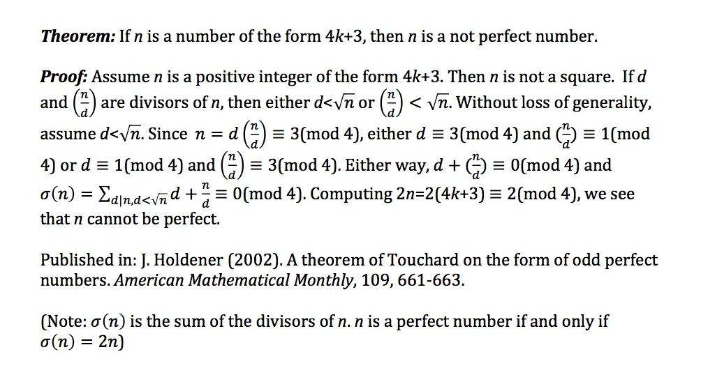

Slide 42
The following proof was generated by a mathematics major in an introduction to proof course.
Theorem: If n is an odd natural number, then n² is odd.
Student-generated proof: 1² =1, which is odd. 3² = 9, which is odd. 5² = 25, which is odd. I am convinced that this pattern will hold and the result will always be true. Therefore, whenever n is odd, n² is odd.
Example of student proof cited in K. Weber (2003), Research Sampler on Undergraduate Mathematics Education, published on-line by the MAA.

Slide 46
Cluster concepts:
Predicted consequences
The prototypical proof satisfies all criteria. Proofs that satisfy all criteria would be better representatives of proof than those that satisfy some criteria and would not be controversial.
Proofs that only satisfy some would be controversial and spark disagreement.
There are compound words that qualify “proofs” that satisfy some criteria but not all criteria.
There are default judgments when you hear an argument is a proof– properties you think the argument is likely to have but are not necessarily sure of.
There is no single essence of proof.

Slide 47
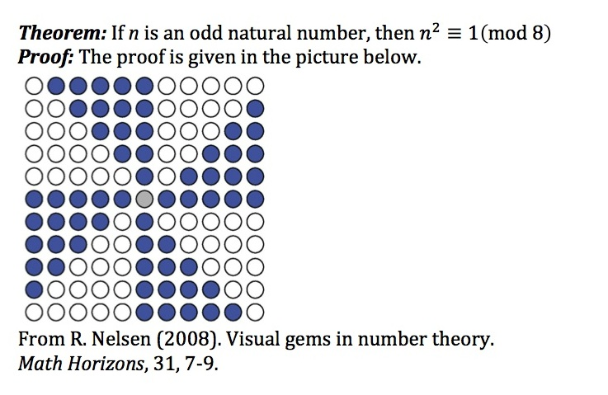

Slide 51
Cluster concepts:
Predicted consequences
The prototypical proof satisfies all criteria. Proofs that satisfy all criteria would be better representatives of proof than those that satisfy some criteria and would not be controversial.
Proofs that only satisfy some would be controversial and spark disagreement.
There are compound words that qualify “proofs” that satisfy some criteria but not all criteria.
There are default judgments when you hear an argument is a proof– properties you think the argument is likely to have but are not necessarily sure of.
There is no single essence of proof.

Slide 52
Default frames
Minsky (1975) introduced the idea of frames as default assumptions about a new situation.
  If we go to a fine restaurant, we expect to be seated and order are food, although we realize that it could be a buffet, prepare your own food, etc.
The notion of cluster concept predicts the elements of the cluster are default options.

Slide 53
Default frames
Participants were told that they came across a conjecture X in an old paper in your field, they asked a respected colleague about the status of the conjecture, and the colleague said, “X was proved by Smith”. What probability would they give to the following?
  If they read the proof, they’d be certain X was true
  If they read the proof, they’d have high confidence that X was true
  They would be capable of filling in any gap in Smith’s proof of X
  They could, in principle, remove any diagram from X without affecting its validity
  Smith’s proof of X would be published in a respected outlet

Slide 54
Default frames
Avg 100% 51-99% 0-50%
Certain of X 81 20% 66% 14%
Confident in X 92 43 55 2
Fill in all gaps 78 13 72 14
No diagram inf. 64 14 49 36
Published 73 8 75 17

Slide 55
Default frames
Avg 100% 51-99% 0-50%
Certain of X 81 20% 66% 14%
Confident in X 92 43 55 2
Fill in all gaps 78 13 72 14
No diagram inf. 64 14 49 36
Published 73 8 75 17

Slide 56
Default frames
Avg 100% 51-99% 0-50%
Certain of X 81 20% 66% 14%
Confident in X 92 43 55 2
Fill in all gaps 78 13 72 14
No diagram inf. 64 14 49 36
Published 73 8 75 17

Slide 57
Default frames
Avg 100% 51-99% 0-50%
Certain of X 81 20% 66% 14%
Confident in X 92 43 55 2
Fill in all gaps 78 13 72 14
No diagram inf. 64 14 49 36
Published 73 8 75 17

Slide 58
Cluster concepts:
Predicted consequences
The prototypical proof satisfies all criteria. Proofs that satisfy all criteria would be better representatives of proof than those that satisfy some criteria and would not be controversial.
Proofs that only satisfy some would be controversial and spark disagreement.
There are compound words that qualify “proofs” that satisfy some criteria but not all criteria.
There are default judgments when you hear an argument is a proof– properties you think the argument is likely to have but are not necessarily sure of.
There is no single essence of proof.

Slide 59
A single essence of proof?
Which of the following best captures the essence of proof?
Proof provides certainty in a theorem
Proof provides high degree of confidence
Deductive argument w each step being logical consequence of previous ones
Proof is a blueprint I can use to write a complete formal proof myself
A proof, in principle, can be translated into a formal argument in an axiomatized theory
Proof explains why a theorem is true
Proof convinces a particular math community a result is true
None of the above captures the essence of proof
There is no single essence of proof

Slide 61
Summary
I proposed that proof can be thought of as Lakoff’s cluster concept.
Empirical verified consequences of this:
  A remarkable level of agreement among a prototypical and a clearly problematic proof
  Disagreement amongst proofs that satisfied some aspects of cluster concept but not others; proof is viewed as contextual and individually-based.
  The majority of mathematicians viewed the cluster concept as defaults
  A single essence of proof was not agreed upon
It might be validity of proof is agreed upon in prototypical cases but disagreement is made on cases where arguments satisfy some, but not all, aspects of the cluster.

Slide 62
Consequences of a cluster concept
Fallis (1997, 2002) argued that probabilistic proofs (Rabin’s primality tests) should be epistemologically on par with proofs.
  Probabilistic proofs do not provide certainty, but proofs with errors are accepted so they cannot provide certainty either.
  Probabilistic proofs do not explain why, but exhaustive proofs do not provide explanation either.
  Probabilistic proofs are not a priori but neither are computer-assisted proofs
  “I have been considering epistemic objectives one at a time. However, it is conceivable that some disjunction of these epistemic objectives might explain the rejection of probabilistic proofs. Unfortunately, it is not immediately clear what this disjunction could be or that such a disjunction would provide a satisfying explanation” (Fallis, 2002).

Slide 63
Consequences of a cluster concept
For math education, perhaps proof is not a useful construct for teaching younger children
  For mathematicians it is, because the elements of the cluster correlate highly, they share default expectations, and they have technical competence. Hence, proof* are unusual.
  For students, there is no reason to suppose the elements are correlated, expectations are being learned, and they have naturally error prone. Nearly every student proof will be a proof*.
  The individual components of the model may be more basic to students.
  Consequently, might it be better to speak of “convincing arguments”, “comprehensible (clear) arguments”, “deductive arguments”, “algebraic arguments”, etc.?

Slide 64
Thank you
Contact me:
keith.weber@gse.rutgers.edu

