Slide 1

Scholarly and sub-scientific mathematical cultures: a reassessment
Albrecht Heeffer
Max Planck Institute for History of Science, Berlin
Center for History of Science, Ghent University
Cultures of Mathematics IV
22-25 March 2015
New Delhi, India

Slide 2
Overview
Hoyrup’s distinction of 1990
Application to mathematical cultures
Criteria and examples
Contemporary distinctions

Slide 3
Original term
Høyrup, Jens (1990)
“Sub-Scientific Mathematics: Observations on a Pre-Modem Phenomenon”, History of Science, 28:63-86.
follow-up:
  “Sub-scientific mathematics: undercurrents and missing links in the mathematical technology of the Hellenistic and Roman world”,
  In Measure, Number and Weight, 1994, SUNY

Slide 4
Sub-scientific knowledge
distinction applies to the organization of knowledge
not just a collection of tricks and rules of thumb
Høyrup: “In order to emphasize both the organized character of this kind of specialists’ knowledge going ‘beyond the common perceptions of man’ and the distinct character of this organization, I have suggested the term ‘subscientific knowledge’”
examples of organized sub-scientific mathematical knowledge:
  recreational problems
  ‘practical’ arithmetic

Slide 5
Misunderstandings
Distinction does not imply:
theoretical vs. practical mathematical knowledge
  scientific knowledge: knowledge for the sake of knowing
  sub-scientific knowledge: specialist knowledge acquired and disseminated for its use
superiority of ‘scholarly’ over ‘sub-scientific’ mathematics
‘sub-scientific’ mathematics as a phase towards scholarly mathematics

Slide 6
1. Theoretical vs. practical
Aristotle, Metaphysics, (981b 14 – 982a1)
  theoretical vs productive knowledge
“At first he who invented any art whatever that went beyond the common perceptions of man was naturally admired by men, not only because there was something useful in the inventions, but because he was thought wise and superior to the rest. But as more arts were invented, and some were directed to the necessities of life, others to recreation, the inventors of the latter were naturally always regarded as wiser than the inventors of the former, because their branches of knowledge did not aim at utility. Hence when all such inventions were already established, the sciences which do not aim at giving pleasure or at the necessities of life were discovered, [...] So [...], the theoretical kinds of knowledge [are thought] to be more the nature of Wisdom than the productive”

Slide 7
2. No normative distinction
the distinction does not imply the superiority of scholarly over sub-scientific knowledge
however, scholarly traditions have been regarded superior
  in different cultures (Japan, Renaissance, ..)
  in the historiography of mathematics
  when sub-scientific traditions show an influence of other cultures
    Humanists vs. Arabic influences
    reception of Indian mathematics in the 19th century
if not considered inferior, sub-scientific traditions have been neglected in historiography

Slide 8
3. Co-existence
Scholarly and sub-scientific knowledge can co-exist
Examples studied by Høyrup:
  Old-Babylonian mathematics
  Medieval tradition
  Arabic mathematics

Slide 9
Proposal
application of the distinction to mathematical cultures rather than mathematical knowledge
more a sociological distinction than an epistemological one
  epistemological differences exist, but they also exist between scholarly cultures (East – West)
examples of scholarly and sub-scientific cultures in different traditions:
  Old-Babylonian
  Ancient China
  India
  Japan (Edo period)
  Medieval Europe

Slide 10
Categories of distinction
use of language
circulation of knowledge
social support
openness for foreign influences
systems of enculturation
historiography

Slide 11
Category 1: Language
Scholarly cultures
Sub-scientific cultures
Learned languages
Old-Babylonian: Sumerian (language for scribes)
India: Sanskrit
Europe, Medieval Latin tradition
Vernacular
Old-Babylonian: Akkadian, Eblaite
India: vernaculars
Europe, abbaco tradition: Italian, Catalan, Provencal

Slide 12
Category 2: Knowledge dissemination
Scholarly cultures
Sub-scientific cultures
Written tradition
authoritative texts
commentaries
Examples
Old-Babylonian: scribal class
India: scholastic tradition
Europe: scholastic tradition
  quadrivium (Boethius, Euclid)
Oral tradition
master-apprentice relations
secret treatises, notebooks
Examples
Old-Babylonian: surveyors
India: merchant class
Europe: abbaco masters
  treatises as a trade secret passed down family generations (the Calandri)

Slide 13
Category 3: Social support
Scholarly cultures
Sub-scientific cultures
Official authorities: emperor, king, princes, capital
supported
defended against contamination
Examples
China: xylographs of the ten computational manuals
Europe: quadrivium at the universities
Lay culture
surveyors (geometry)
merchants, artisans (arithmetic and algebra)
Examples
Old-Babylonian: surveyors
India: merchant class
Europe: abbaco masters educating the merchants

Slide 14
Category 4: Openness
Scholarly cultures
Sub-scientific cultures
Conservative, defensive
reject change
hostile against foreign influences
Examples
China: xylographs of the ten computational manuals
Europe: humanists eradicating ‘barbaric’ influences
Open for foreign influence
cross-cultural
mathematical practice travelling through merchant routes
Examples
silk route recreational problems
Europe: abbaco culture embracing algebra

Slide 15
François Viète
In his dedication to Princess Mélusine (Isagoge, 1591):
Behold, the art which I present is new, but in truth so old, so spoiled and defiled by the barbarians, that I considered it necessary, in order to introduce an entirely new form into it, to think out and publish a new vocabulary, having gotten rid of all its pseudo-technical terms (pseudo-categorematis) lest it should retain its filth and continue to stink in the old way

Slide 16
François Viète
New terminology for algebra:
logistica speciosam (symbolic logistic): algebra
zetetics: translation of a problem into a symbolic equation
poristics: manipulation of the equation by the rules of algebra
exegetics: interpretation of the solution of the problem
latus (res): the unknown, shay’
quadratus (census): square of the unknown, māl
antithesis (restoration): al-jabr (ﺍﻠﺠﺑﺮ)
hypobibasmo (reduction): al-ikmāl (ﺍﻺﻜﻤﺎﻝ )
parabolismo (reduction): id.
Use of Diophantus

Slide 17
Category 5: Enculturation
Scholarly cultures
Sub-scientific cultures
Official education
elite system
rote learning
Examples
Old-Babylonia: scribal schools
Europe: universities
Education system supported by lay culture
schools
learning by doing (calculating)
apprenticeship
Examples
Europe: abbaco schools teaching Hindu-Arabic arithmetic

Slide 18
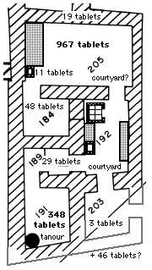
Enculturation in scholarly culture
Almost 4000 years of math education
Babylonian scribal schools: first organized classes for mathematics education
  Iraq, Nippur, House F, c.1900-1721 BC, excav. 1952
  127 tablets of the school tablets deal with mathematics (18%)
  7 similar excavation sites found
knowledge of mathematics very important to the scribal class

Slide 19
Category 6: Historiography
Scholarly cultures
Sub-scientific cultures
Dominant in the history of mathematics
Ancient Greece as a model
Examples
Humanist myth: all valuable knowledge emerged from Ancient Greek soil
Moritz Cantor
History undervalued, understudied
past 30 years
Examples
Europe: abbaco culture (studied since 1960’s)
Old-Babylonian algebra: the new interpretation (1980’s)

Slide 20
Mathematics of sub-scientific cultures
merchant arithmetic and algebra
  rule of three
  exchange of money
  barter
  partnership and partnership in time
  interest and discount
  repayment of loans
  alligation (of metals or liquids)

Slide 21
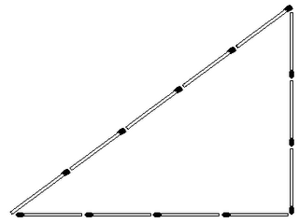
Mathematics of sub-scientific cultures
Practical geometry
  from surveying tradition (Old-Babylonian)
  master builders, architects
  mensuration
    distances, surfaces, volumes
  gauging
  perspective
  fortification, balistics
  sun-dials

Slide 22
Mathematics of sub-scientific cultures
Recreational problems
  riddles
  lack of care for reality
  surprise or awe effect
  culturally embedded
  often ‘trick’ solution or easy recipe
  teaching function
  cross-cultural

Slide 23
Influences between cultures
1. Institutionalization
sub-scientific knowledge is incorporated into scholarly culture
examples:
  land administration: Old-Baylonian algebra
  taxation on commerce: Ancient China

Slide 24
Example 1: incorporating surveyors knowledge into scribal culture
J. Friberg (2009) “A Geometric Algorithm with Solutions to Quadratic Equations in a Sumerian Juridical Document from Ur III Umma”, Cuneiform Digital Library Journal 2009, (3).
  YBC 3879, a juridical field division document from the Sumerian Ur III period (2100-2000 BC)
  the first documented appearances of metric algebra problems in a pre-Babylonian text
  the first documented appearance of metric algebra problems in a non-mathematical cuneiform text

Slide 25
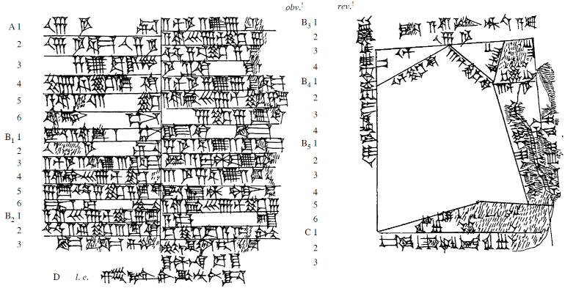
YBC 3879

Slide 26
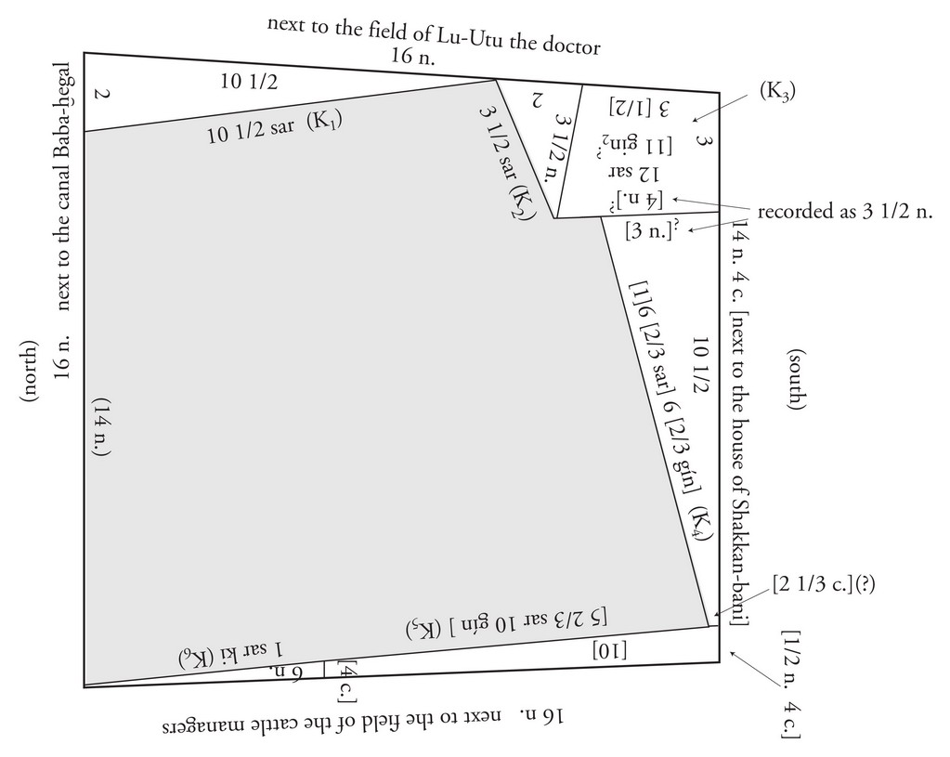
YBC 3879 Field plan
K₁: triangle
K₂: triangle
K₃: quadrilateral
K₄: trapezoid
K₅: trapezoid
K₆: triangle

Slide 27
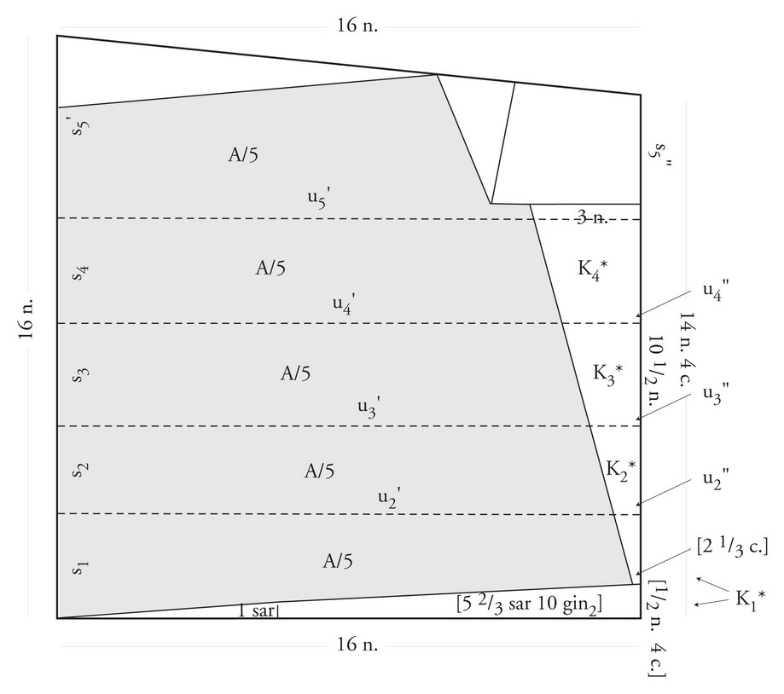
YBC 3879 Division of land
Dividing the remaining land into 5 strips of equal area

Slide 28
YBC 3879 method
p
Given: p, f, B
f: constant
Find the area of the trapezoid
B
s
f/2.s

Slide 29
YBC 3879 method
2p
Transform by scaling x 2
F
b
b

Slide 30
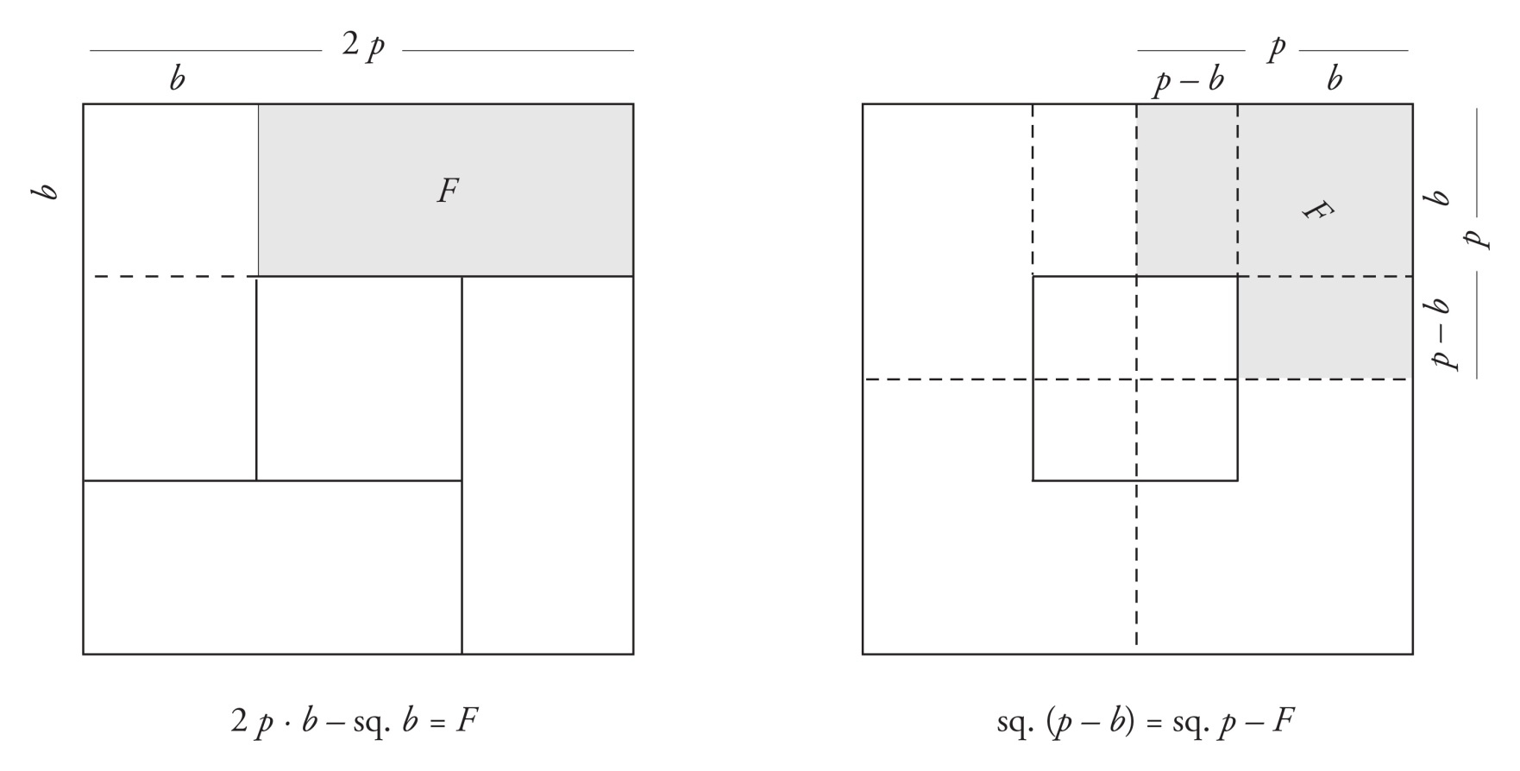
YBC 3879 method
F and p known
p – b can be computed

Slide 31
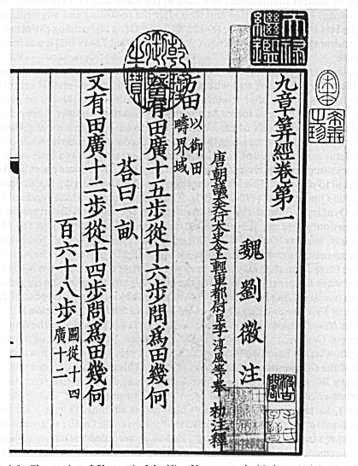
Example 2: institutionalizing sub-scientific mathematical culture
The 10 computational manuals of Chinese mathematics
  Officially compiled with the Tang dynasty (618-627)
  Xylographed in 1084, 1213
  Printed in 1407, 1573, 1728, 1773, 1794

Slide 32
The ten computational manuals
Chinese Title | Translation | Author | Date
Zhoubi suan jing | Gnomonic computations | ?? | 100 BC-600
Jiu zhang suan shu | Nine chapters | ?? | 200 BC-300
Haidoa suan jing | Sea Island manual | Liu Hui | 3th cent
Sun Zi suan jing | Sun Zi’s comp. manual | Sun Zi | 5th cent
Wu cao suan jing | Five administrative sections | ?? | 5th cent
Xiahou Yang suan jing | Xiahou Yang’s manual | Xiahou Yang | c.350
Zhang Qiujian suanjing | Zhang Qiujian’s manual | Zhang Qiujian | 466-485
Wu jing suan shu | Five classics | ?? | 566
Shu shu ji yi | Traditional numerical proc. | Zhen Luan | 6-7th cent
Sandeng shu | Art of the three degrees | Zhen Luan | 6-7th cent
Jigu suan jing | Continuations of ancient | Li Chunfeng | 7th cent
Zhui shu | Method of Interpolation | Li Chunfeng | 7th cent

Slide 33
Need for calculation in administration
Typical example: The Nine Chapters (6: Jūn shū)
Now there is a man carrying hulled grain, who passes through three customs posts: the outer post takes 1 in 3; the middle post takes 1 in 5; the inner post takes 1 in 7; the remaining hulled grain is 5 dŏu. Question: how much was he originally carrying?

Slide 34
Influences between cultures
2. Merging cultures
mathematics from sub-scientific culture is brought onto scholarly culture
examples:
  India: classical period (600 – 1200 AD)

Slide 35
Example: Āryabhaṭīya आर्यभटीयम्
Primarily astronomical treatise (dated 499)
400-600 also called “The astronomical period”
Contents
  astronomical constants and the sine table
  mathematics required for computations (gaņitapāda)
  division of time and rules for computing the longitudes of planets using eccentrics and ellipses
  the armillary sphere, rules relating to problems of trigonometry and the computation of eclipses (golādhyaya)

Slide 36
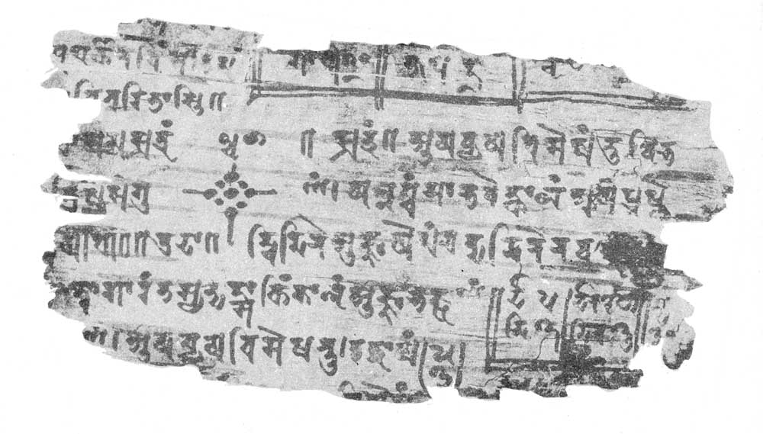
Sub-scientific culture: Bakhshālī Manuscript
Discovered in the village Bakhshālī in 1881
Sanskrit text on 70 leaves of birch bark
Mostly practical and merchant arithmetic
Phd by Takao Hayashi (1995)
  dated 7th century
  but contains earlier material
Merchant arithmetic
  proportional division
  rule of inversion
  rule of false position
  …

Slide 37
Influences between cultures
3. scholarly culture transcends a dominant sub-scientific culture
scholarly mathematical cultures from sub-scientific culture is
examples:
  Edo period Japan: Seki school

Slide 38
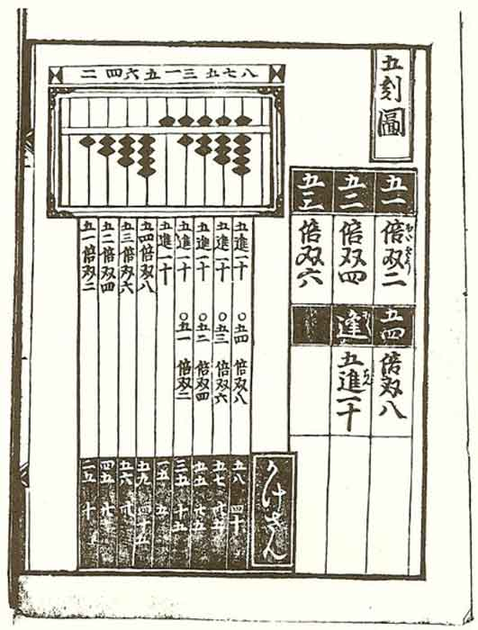
Jinkōki (1627)
by Yoshida Mitsuyoshi (吉田 光由)
first important wasan book
used as a textbook for merchants children at the Terakoya (private school)
expanded and printed in more than 300 editions (up till the 20th century)
modern English edition (Wasan Institute, 2000)
1641 edition

Slide 39
Jinkōki (1641)
Book 1, 19 chapters:
  numeration, units of volume, area & weight, : multiplication tables and divison, soroban excercises, practical excercises, exchange and interest
Book 2, 13 chapters:
  commercial problems, area and volume calculation
Book 3, 24 chapters:
  Josephus problem, distance and height calculation, geometric progressions, chinese remainder problem, square and cubic root, pi
Supplement, 12 unsolved problems:
  quadratic, volume of a sphere, polygons, tesselation, inheritance, binomial coeficients, triangle problems

Slide 40
Seki school
new scholarly mathematical culture
Seki Takakazu (関 孝和, 1642 – 1708)
  raised within wasan culture
  worked as a surveyor
  familiar with Chinese works using the Celestial element method (higher degree algebra)
  translated in 1658 by Hisada Gentetsu, titled Sanpō ketsugishō (算法闕疑抄)
  refined by Seki (side writing method)

Slide 41
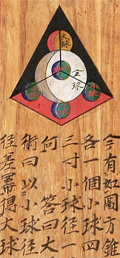
Sangaku
San Gaku (算額, mathematical tablet)
placed as offerings at Shinto shrines or Buddhist temples
final solution usually given
only a dozen books with sangaku collections
some in unpublished manuscripts
most wooden tablets lost
about 900 tablets extant
1800 known to be lost
active period about 1680 – 1868
practiced by samurai as well as merchant class

Slide 42
Enculturation by sangaku
Purpose?
esthetic
  mathematics as art
religious and spiritual
  tablets are devotive
  As testified by a Kakuyu, a student of the wasan master Takeda, "his disciples ask God for progress in their mathematical ability and dedicate a sangaku"
social
  intelectual pursuit
  means of communication (posting solved and unsolved problems)
  social recognition
enculturation
  motivating an appreciation for mathematics
  draw student to a wasan school

Slide 43
Influences between cultures
4. a sub-scientific culture replaces an existing scholarly culture
a scholarly mathematical culture becomes archaic as a sub-scientific culture is more succesful
examples:
  Europe: Hindu-Arabic numerals (11th – 15th Cent) and arithmetic

Slide 44
Operations on fractions
Arabic: hisāb al-hind
Roman practical arithmetic
Gerbert (c. 1000)
Maghreb practices (1150-1400)
Liber Mahamaleth
Latin algorisms (1150-1450)
Fibonacci (1202)
Abbaco tradition (1260-1500)
Jean de Murs, QN, 1343
Bianchini, Regiomontanus, 1460
Latin scholarly tradition
Sub-scientific tradition

Slide 45
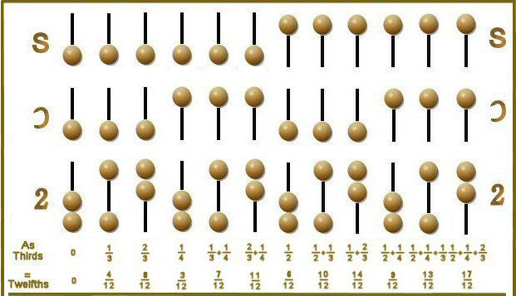
Roman fractions (10th – 13th cent)
Gerbert: regule de abaco computi (996)
Similar to monetary and weight units
  1 as = 12 unciae (ounces and inches)
  1 uncia = 24 scripuli
  1 scripulus = 6 siliquae
  1 siliqua = 3 oboli
  Total of 5184 fractional parts
performed on the abacus

Slide 46
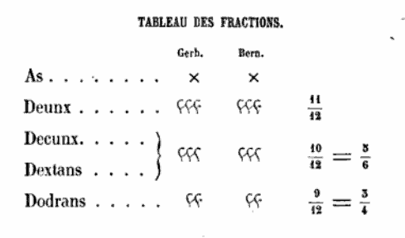
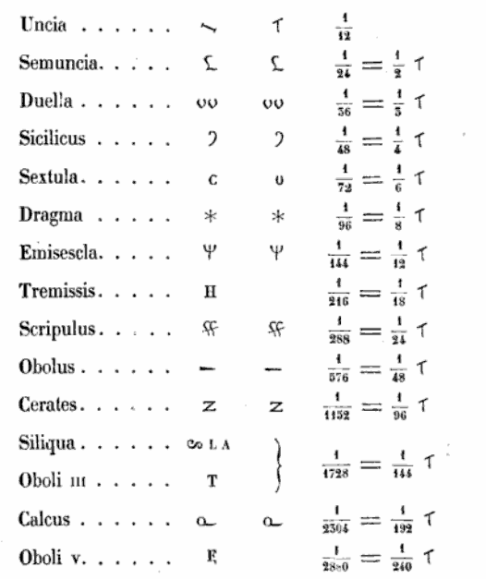
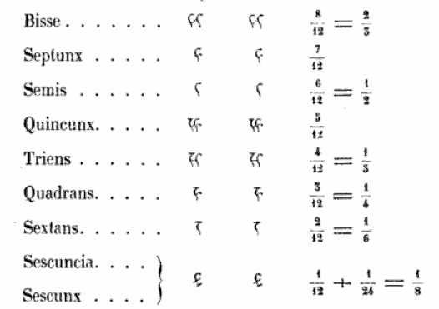
Gerbert (996) and Bernelinus (11th C)

Slide 47
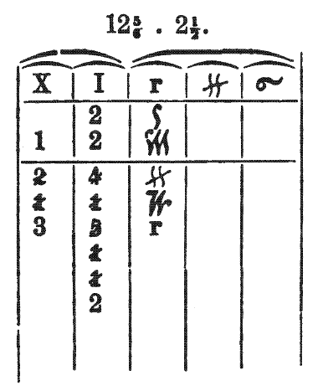
Operations on Roman fractions
Multiplying fractions on the Gerbertian abbacus
XII dextae mul. II semis
fractions colums
  unciae
  scripuli
  calci
adding the unciae column
  2/3 + 5/12 = 1 1/12
  bisse et quincunx
numbers denote apices (tokens or jetons)
pictorial representations in manuscripts (from 11th cent)

Slide 48
Contempory era
Which are the sub-scientific mathematical cultures today?
  ethnomathematics
  merchant arithmetic
  artisan knowledge
  recreational mathematics
  mathematics education

Slide 49
Merchant aritmetic
the soroban is still occasionly used in shops in Japan and China
double-entry bookkeeping of the 14th century is today’s worldwide accounting system
  system that conserves the Medieval number concept avoiding negative values
  “On the curious historical coincidence of algebra and double-entry bookkeeping” in Karen François, Benedikt Löwe and Thomas Müller and Bart Van Kerkhove (eds.) Foundations of the Formal Sciences VII. Bringing together Philosophy and Sociology of Science, College Publications, London, 2011, pp. 109-130.

Slide 50
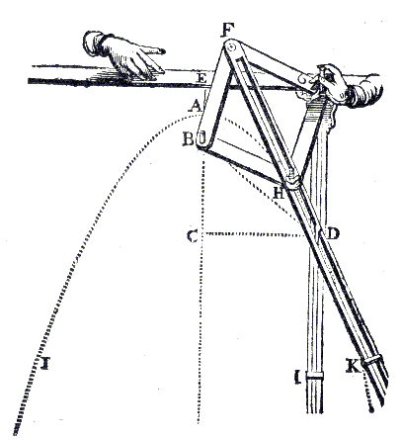
Artisan knowledge
Today machines and instruments replace artisan knowledge of mathematics
  but also during the 16-17th centuries
    instruments to trace a parabola or ellipse
Knowledge embedded in material tools
Frans Van Schooten, 1646

Slide 51
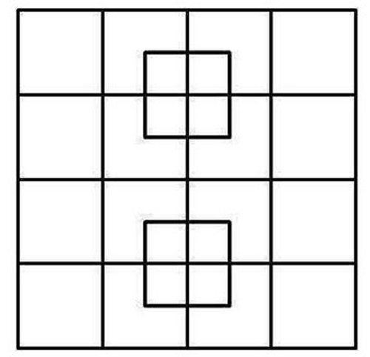

Recreational mathematics
Still part of a sub-scientific culture
  puzzles and riddles shared on Facebook
  Pi-day 3-14-15 with pies and π-beer
but has become a scholarly culture also
  dedicated journals or columns in mathematical journals
    The Mathematical Intelligencer, Mathematics Today, ..

Slide 52
Mathematics education
large potential for sub-scientific mathematics (connected with history of mathematics)
  example 1: popularity of “Vedic mathematics” for mental calculations in India
  example 2: revival of wasan and the soroban in Japanese education
  movie fragment NHK World – Japanology, 2011, 21:45 – 23:44

Slide 53
Thank you

